Slide 1
UH Systematics fall 2019:
Biogeography
Camiel Doorenweerd
20191008

Slide 2
Biogeography is a special case of character state evolution

Slide 3
Alfred R. Wallace

Slide 4
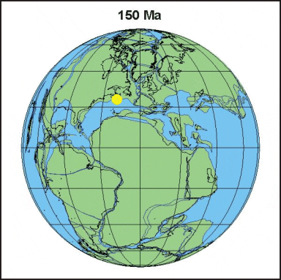
Plate tectonics shaped biogeographic patterns

Slide 5
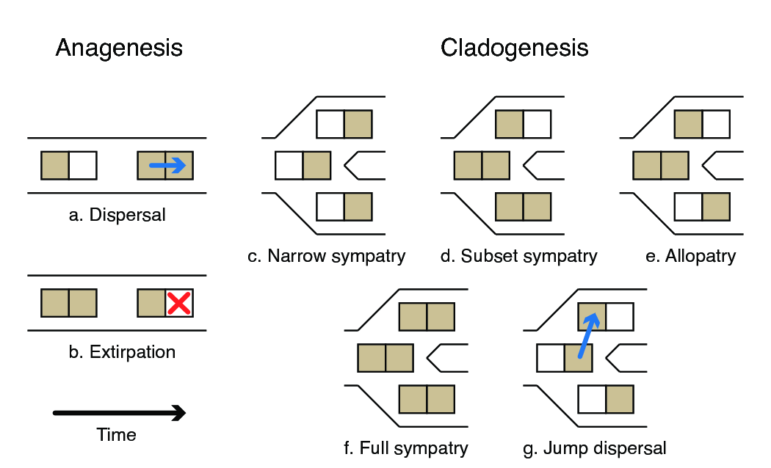
Anagenesis & cladogenesis
https://revbayes.github.io

Slide 6
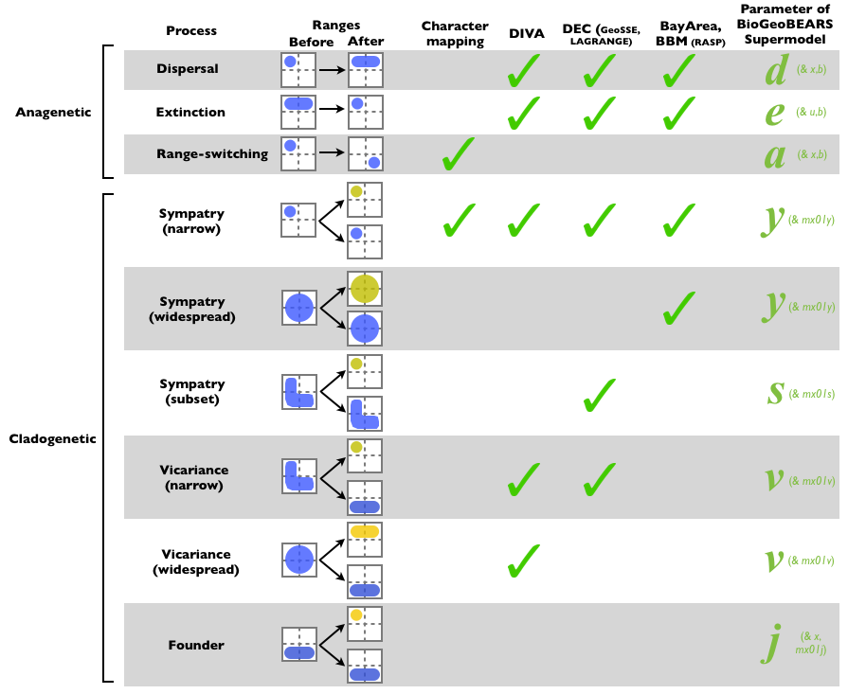
Selecting a model
http://phylo.wikidot.com/biogeobears

Slide 7
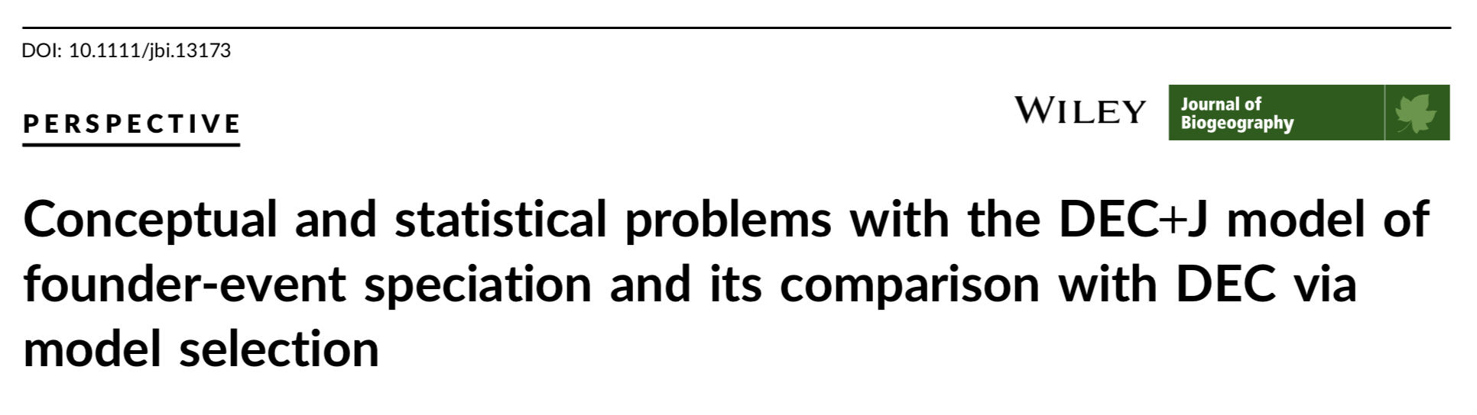
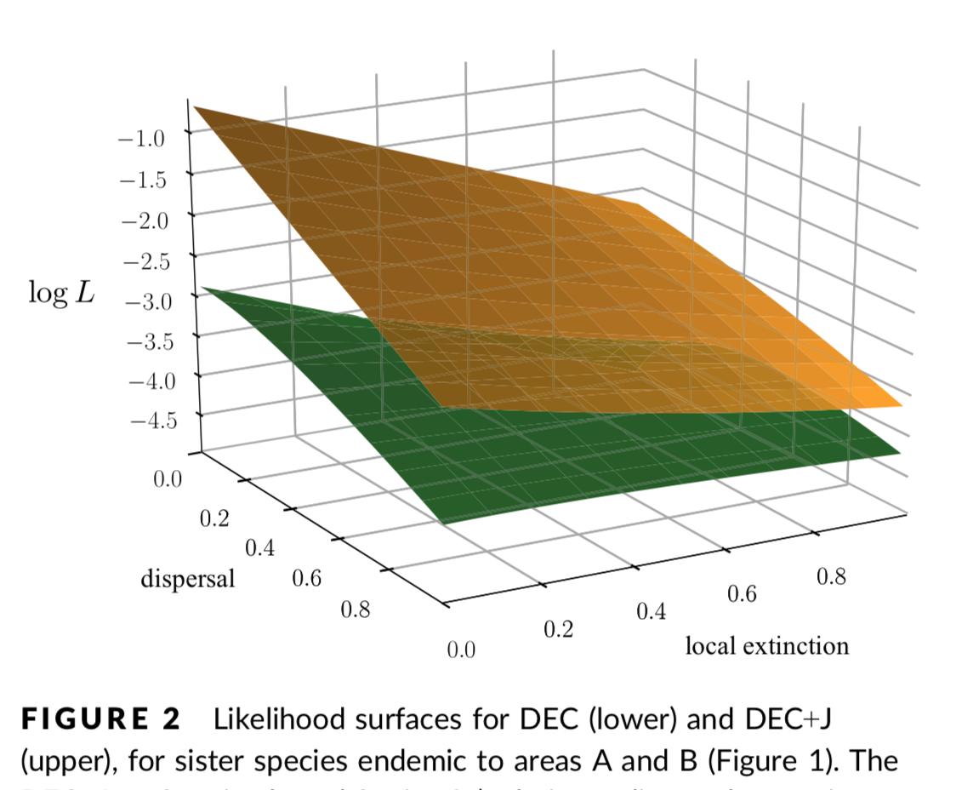
Ree & Sanmartín 2018

Slide 8
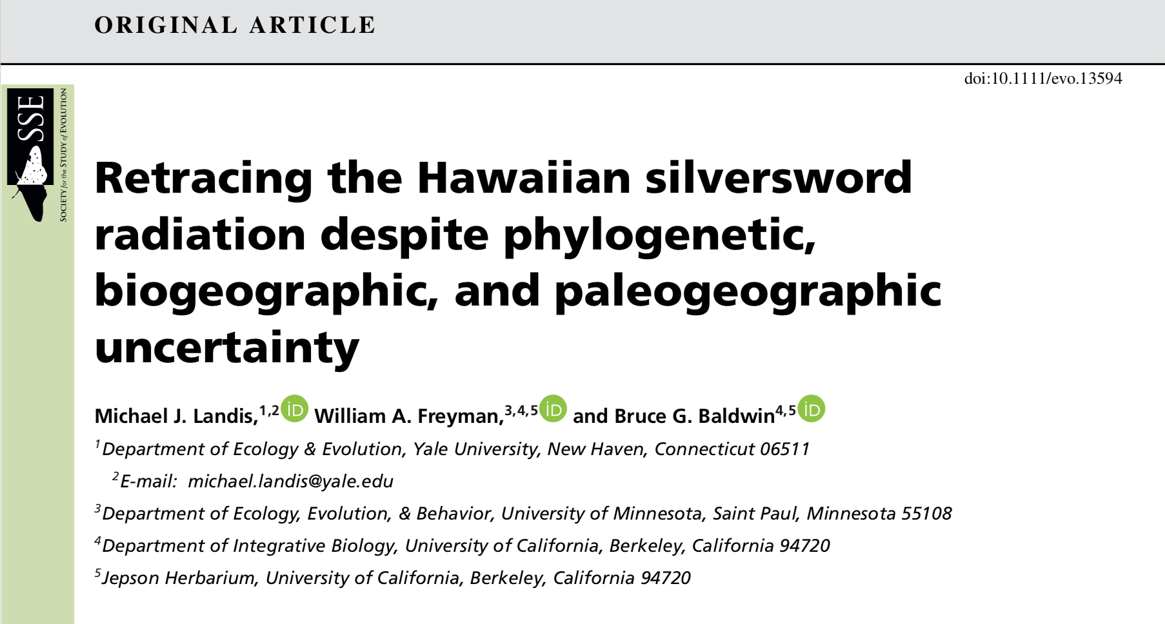
Further model parameters: Hawaiian silverswords example

Slide 9
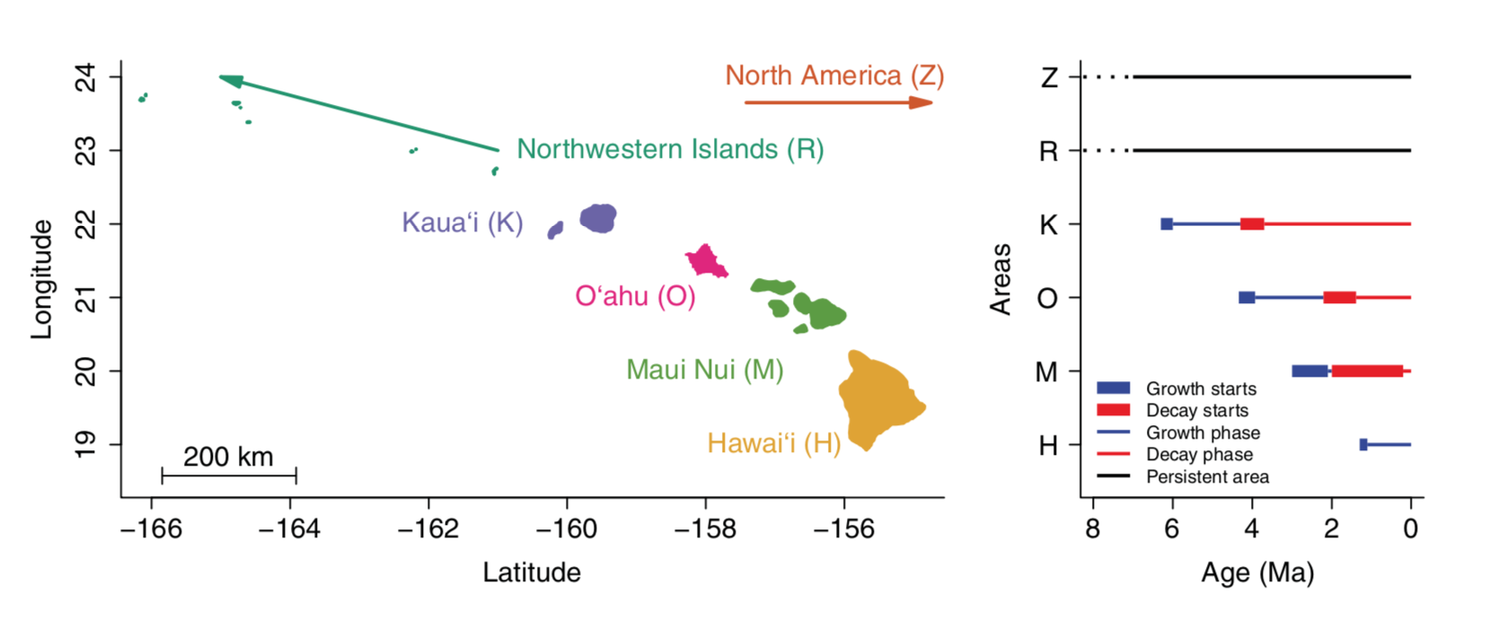
The Hawaiian archipelago

Slide 10
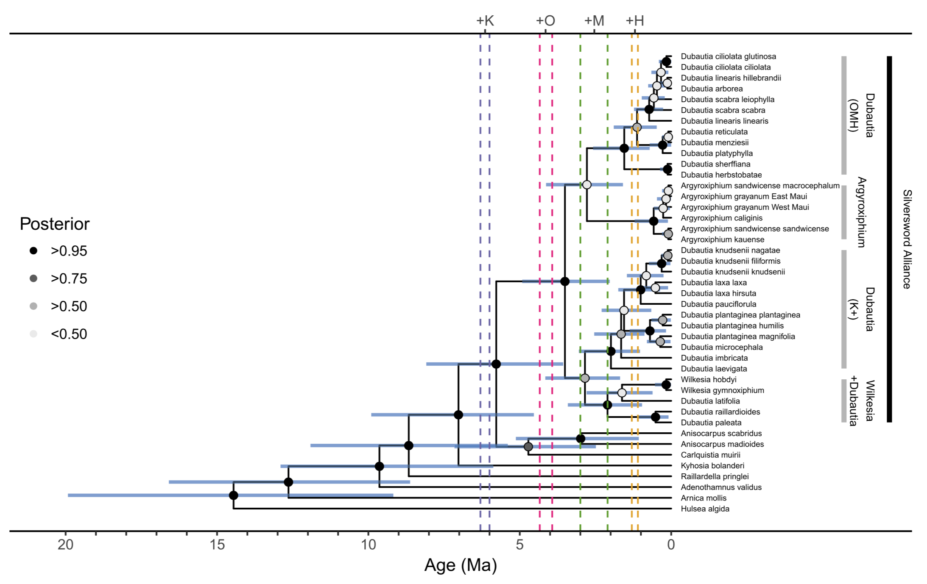
Silverswords & tarweeds

Slide 11
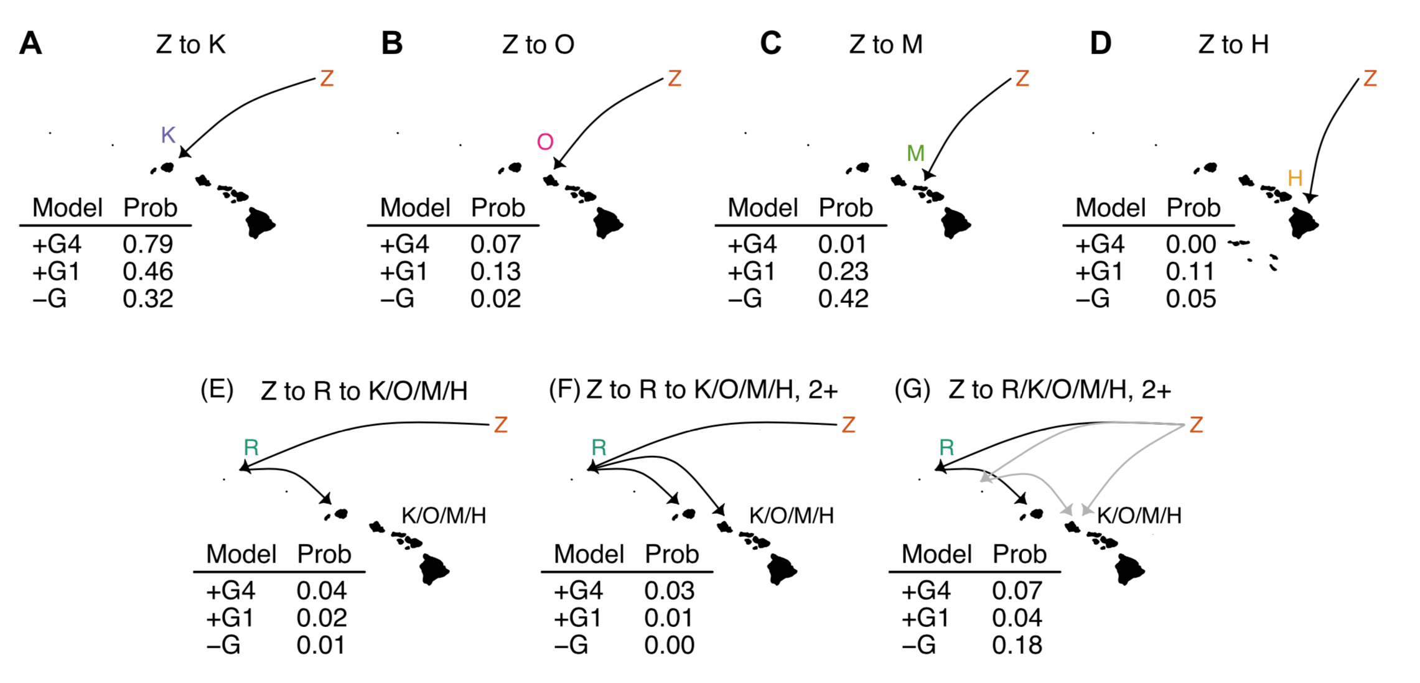
Which island was colonized first?

Slide 12
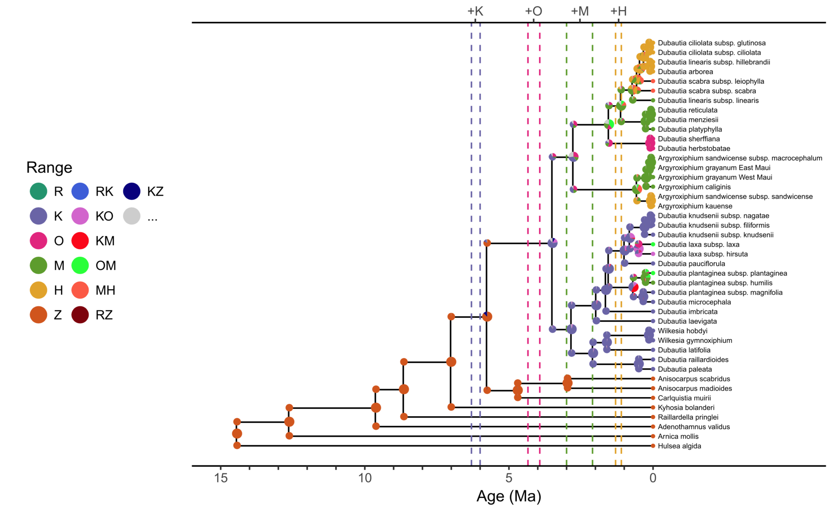
The ‘progression rule’

Slide 13
Lab:
Biogeobears versus RevBayes
Jupyter notebook
Select sensible regions
Select sensible scenarios
Saturnia Biogeography

Slide 14
References
Ree RH, Sanmartín I (2018) Conceptual and statistical problems with the DEC+J model of founder-event speciation and its comparison with DEC via model selection. Journal of Biogeography 45: 741–749. https://doi.org/10.1111/jbi.13173
Landis MJ, Freyman WA, Baldwin BG (2018) Retracing the Hawaiian silversword radiation despite phylogenetic, biogeographic, and paleogeographic uncertainty. Evolution 72: 2343–2359. https://doi.org/10.1111/evo.13594

